Slide 1

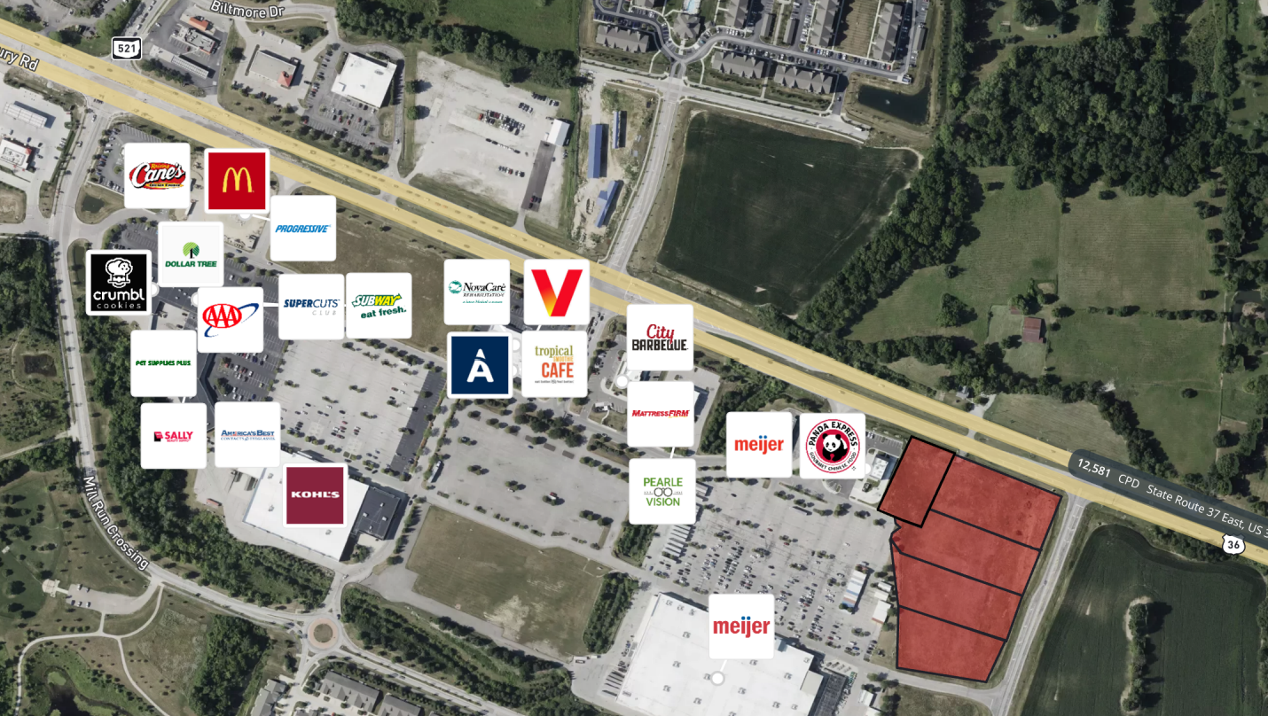




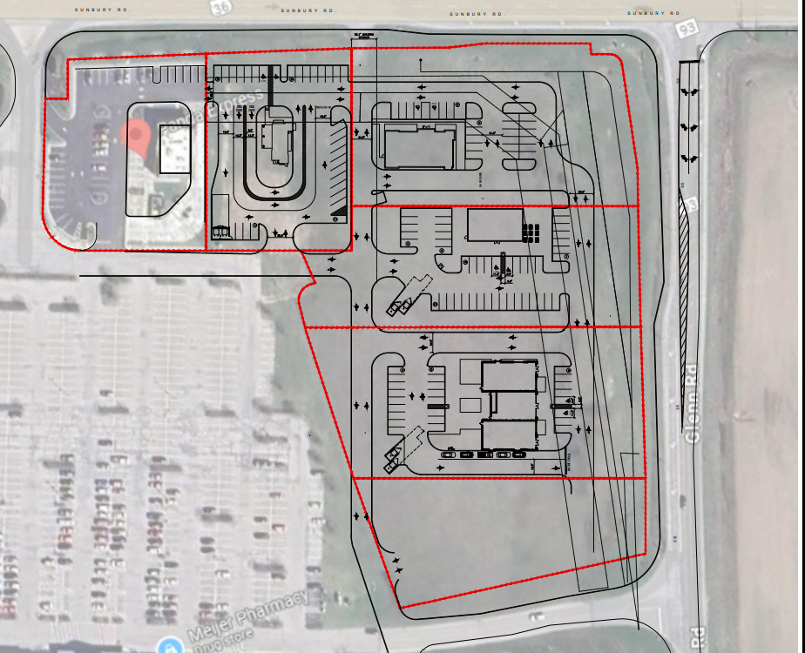

DELAWARE
Up to 2.6 Acre Opportunity | 1550 Sunbury Road, Delaware, OH 43015
www.oliodevgrp.com
LAND LEASE OPPORTUNITY | PAD READY, BUILD-TO-SUIT AVAILABLE
ZONING | PLANNED MIXED-USE OVERLAY | DRIVE-THROUGH PERMITTED | SUBDIVIDABLE
PROPERTY DETAILS
DISTANCE TO HIGHWAYS | 3.2 mi to US-36/I-71 interchange | New Sunbury Parkway/I-71 interchange under construction ($32M Phase 1), 7 min to Route 42
TRAFFIC | 28,008+ VPD Sunbury Road (US-36/SR-37) | Signalized intersection at Glenn Road
ACCESS | Dual access off Sunbury Road | Full signalized intersection
ANCHORS | Meijer | Kohl’s Glenwood Center | 674,293 SF across 78 acres
COMING SOON!
COMING SOON!
+
NATIONAL QSR
LEASED
1.11 AC
LEASED
AVAILABLE
1.44 AC
AVAILABLE
COMING SOON!
LEASED
CONTACT FOR MORE INFORMATION: Sage Gardner, Director of Real Estate | 614.852.7565 | sgardner@oliodevgrp.com

Slide 2
DELAWARE
Up to 2.6 Acre Opportunity | 1550 Sunbury Road, Delaware, OH 43015
www.oliodevgrp.com
LAND LEASE OPPORTUNITY | PAD READY, BUILD-TO-SUIT AVAILABLE
STRATEGIC LOCATION
TRADE AREA DEMOGRAPHICS
Up to 2.6 acres available at the center of Ohio's fastest-growing county, anchored by 674,293 SF of national tenancy, with verified category voids across QSR, fast casual, and service retail.
 | 1-Mile | 3-Mile | 5-Mile
Population | 5,847 | 42,498 | 89,321
Households | 2,187 | 15,893 | 33,741
Avg. Household Income | $97,412 | $112,634 | $118,907
Median Age | 34.2 | 36.1 | 37.4
Daytime Employees | 3,214 | 18,762 | 41,508
Population Growth (2020–2024) | +9.8% | +11.1% | +10.4%
College Educated (Bachelor's+) | 42% | 48% | 51%
MARKET GROWTH DRIVERS
The 3-mile trade area encompasses 42,498 residents and 18,762 daytime employees, with average household incomes above $112,000 and population growth of 11.1% since 2020. Sunbury Road carries 28,008 vehicles per day along a corridor where Kroger Marketplace, Chick-fil-A, Chipotle, 7Brew, and a second Chase Bank have all broken ground or signed leases within one mile in the past 12 months, representing over $200M in combined investment. A new I-71 interchange under construction 3.2 miles east will add a second access point to the corridor and accelerate absorption across the trade area. Residential growth along the corridor has consistently outpaced commercial development, creating a widening gap between household density and tenant supply.
DEVELOPMENT PIPELINE
$200M+ in combined investment all within 1 mile
Kroger Marketplace | 1650 Sunbury Rd | $33–39M | Groundbreaking September 2025 | Opening 2026–2027
Chick-fil-A | Sunbury Rd & Skyview Ln | Approved | Under Development
Chipotle | Sunbury Rd & Skyview Ln | Same GTZ development as Chick-fil-A | In Development
7Brew Coffee | 1424 Sunbury Rd | Approved December 2025 | Construction Start 2026
Chase Bank (2nd location) | Glenwood Commons | Under Construction
Sunbury Parkway/I-71 Interchange | $32M Phase 1 | Groundbreaking July 2025
Integrated development, construction management, more available through OLIO Development Group.
Learn more about our full suite of services and how we can take you from groundbreaking to grand opening and beyond at
www.oliodevgrp.com.
CONTACT FOR MORE INFORMATION: Sage Gardner, Director of Real Estate | 614.852.7565 | sgardner@oliodevgrp.com

